Slide 1


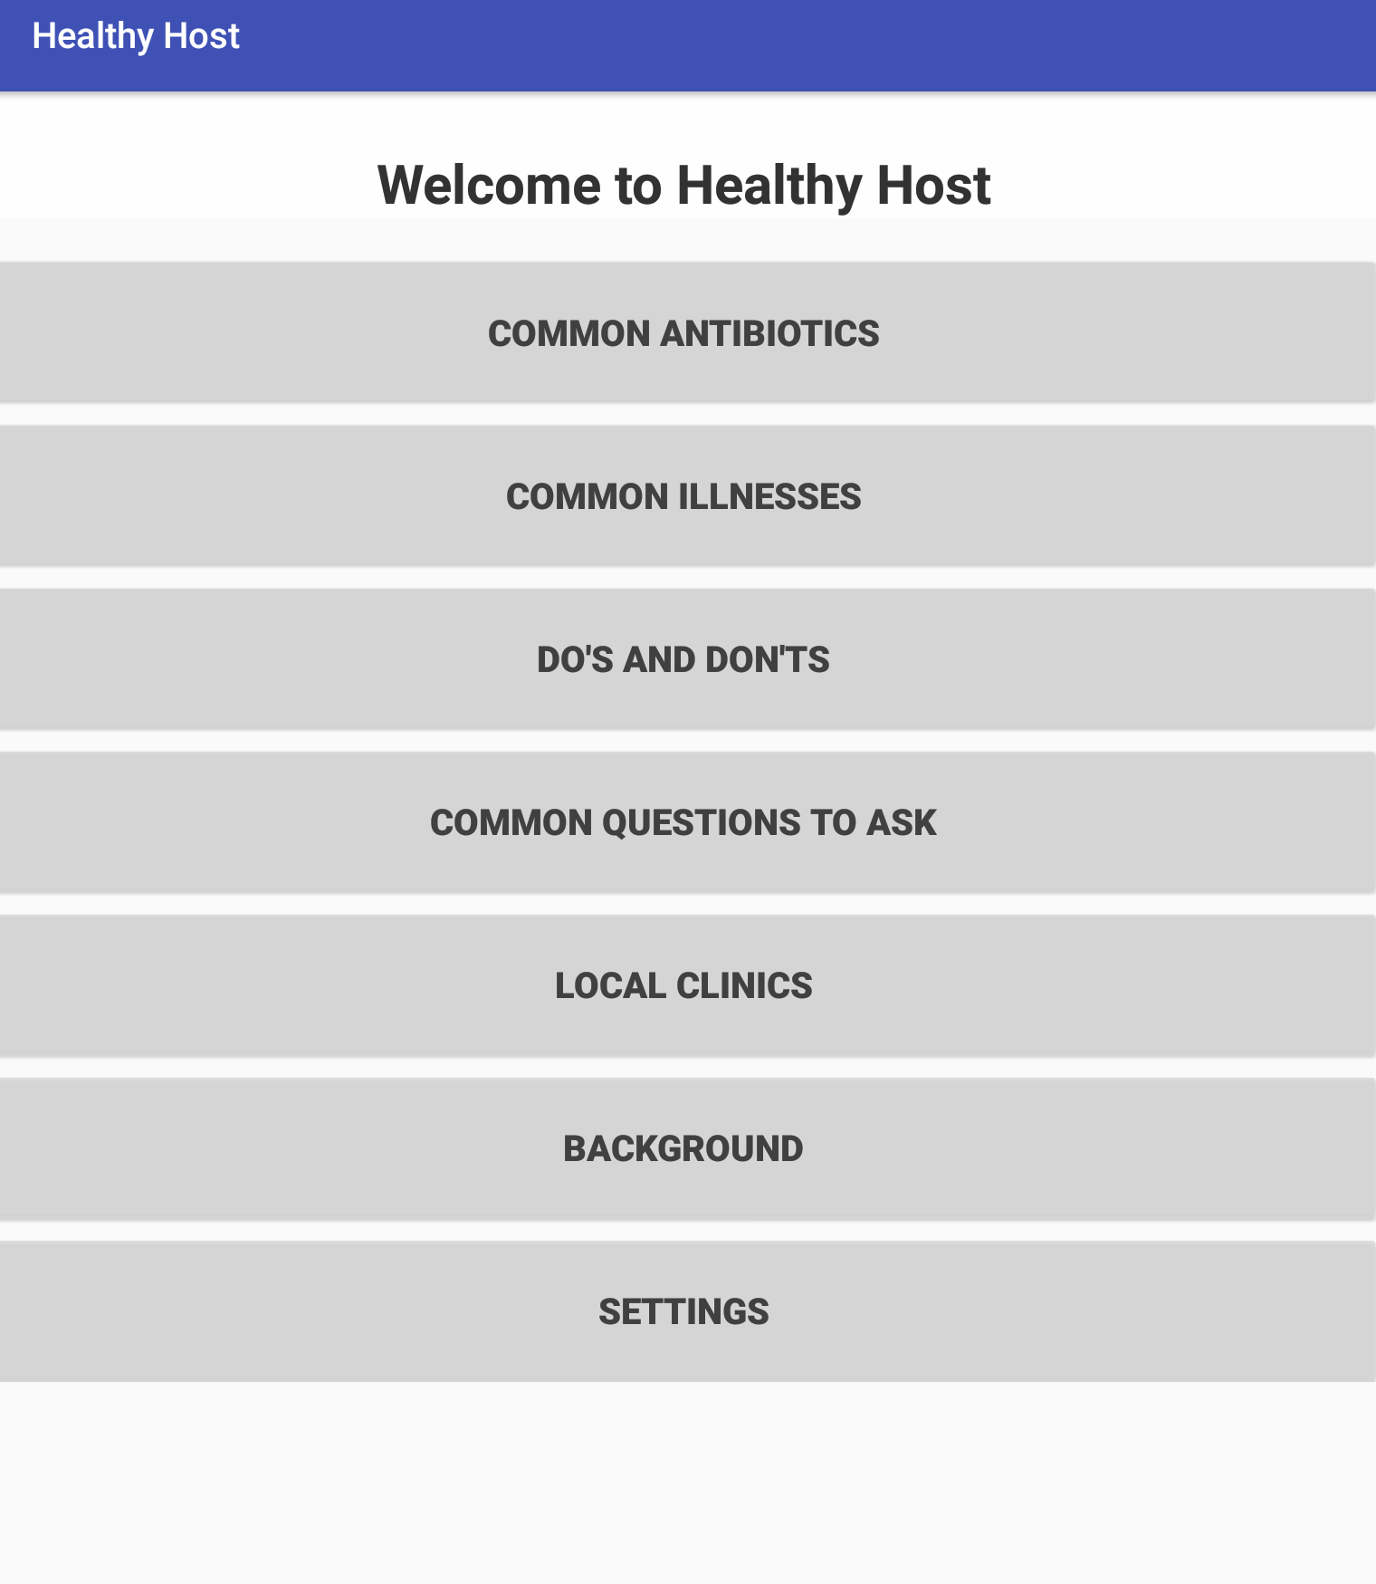
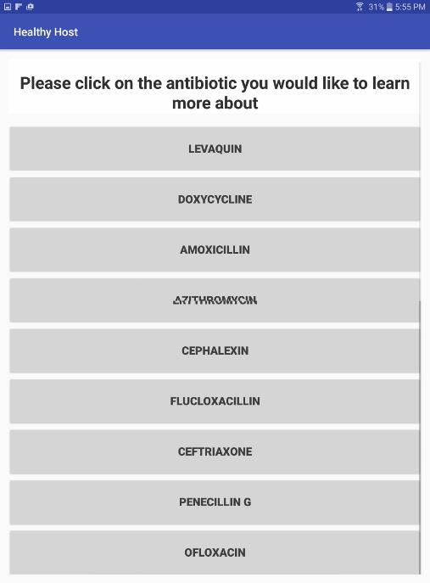
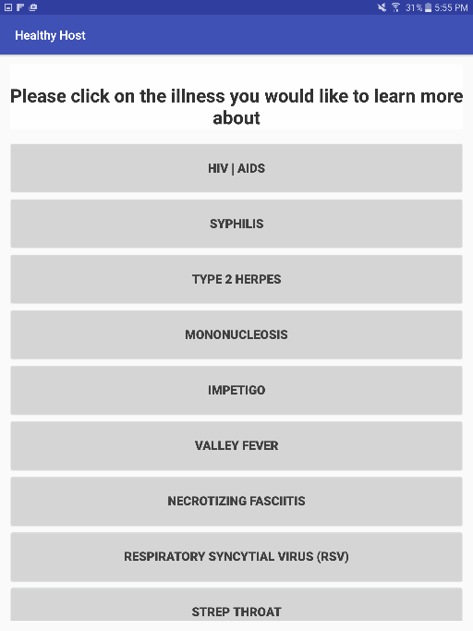
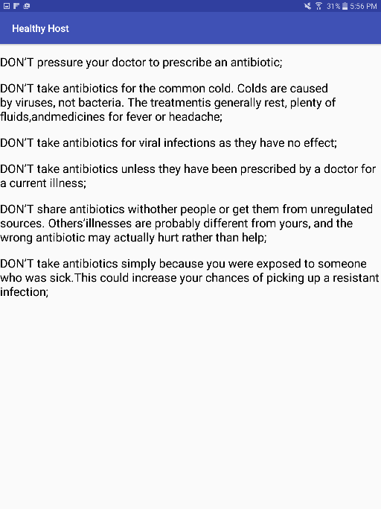
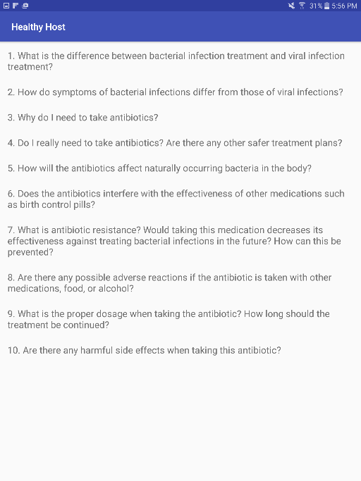
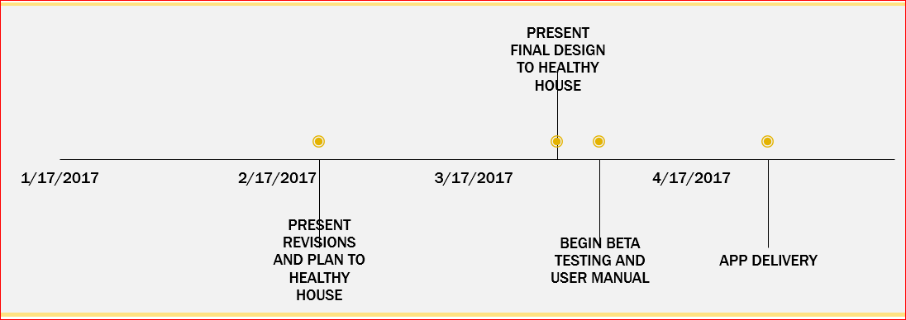
Healthy Host
Mobile Application
Introduction
The Engineering Service Learning team, Project Protect, has been working alongside Healthy House on a mobile phone application that will provide simple and accurate health information to residents of Merced County in multiple languages. The app has the potential to greatly improve the health literacy of the multi-ethnic communities by providing information about the most common bacterial and viral illnesses, medications and treatments, and general questions that patients can ask their doctors. The Project Protect team is currently working on the final design modifications in order to make the app as efficient and user-friendly as possible. The team expects the app to be delivered by April 28, 2017.
Methods
The design and ease-of-access of the application is essential as its user-friendliness for the user and Healthy House is what will keep it afloat after the project is finished. Two teams were established: the Application Development team, and the Quality Assurance team.
The Application Development team will be using Android Studio to create the application for Android mobile devices. Through the use of team member’s programming backgrounds and online training software such as Lynda.com, the team will be designing and implementing the features mentioned in the introduction.
The Quality Assurance team is in charge of revising the content on the application for accuracy and correctness. They will act as “end users” and constantly test the new changes that the Application Development team implements. They will also be in charge of setting up tabling for the general UC Merced Audience to use give feedback.
Design Components
Common Medications
Common Illnesses
Antibiotics
Frequently Asked Questions
Future Plans
Training will be completed prior to the delivery of the Healthy Host application.
Additionally, a user manual will be completed to provide supplementary information on application maintenance and revision of content as needed in the future.
engsl@ucmerced.edu
engineeringservicelearning.ucmerced.edu

